Slide 1

Server Sent Events
Dima Ionut Daniel

Slide 2
Contents
What is SSE?
Architecture
Core
Implementations
SSE vs WebSockets
Bibliography

Slide 3

What is SSE?
Server-Sent Events (SSE) is a server push technology enabling a client to receive automatic updates from a server via an HTTP connection.
They are commonly used to send message updates or continuous data streams to a browser client and designed to enhance native, cross-browser streaming through a JavaScript API called EventSource.
The Server-Sent Events EventSource API is standardized as part of HTML5 by W3C.
The mimetype for SSE is text/event-stream.

Slide 4
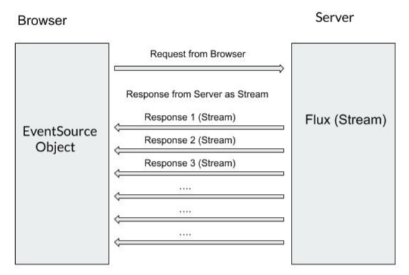
Architecture
Server sends the responses as a Stream of data in the form of Flux.

Slide 5
Core
Technologies supporting server-to-client communication:
Polling
Long-polling
Server-Sent events
WebSocket

Slide 6
Core (cont.)
Polling
With polling a client repeatedly sends new requests to a server.
If the server has no new data, then it send appropriate indication and closes the connection.
The client then waits a bit and sends another request after some time

Slide 7
Core (cont.)
Long-polling
With long-polling a client sends a request to a server.
If the server has no new data, it just holds the connection open and waits until data is available.
Once the server has data (message) for the client, it uses the connection and sends it back to the client.
Then the connection is closed.

Slide 8
Core (cont.)
Server-Sent events
SSE is similar to the long-polling mechanism, except it does not send only one message per connection.
The client sends a request and server holds a connection until a new message is ready, then it sends the message back to the client while still keeping the connection open so that it can be used for another message once it becomes available.
Once a new message is ready, it is sent back to the client on the same initial connection.
Client processes the messages sent back from the server individually without closing the connection after processing each message.

Slide 9
Core (cont.)
WebSocket
WebSocket technology is different from previous technologies as it provides a real full duplex connection.
The initiator is again a client which sends a request to a server with a special HTTP header that informs the server that the HTTP connection may be "upgraded" to a full duplex TCP/IP WebSocket connection.
Once a WebSocket connection is established, it can be used for bi-directional communication between the client and the server.
Both client and server can then send data to the other party at will whenever it is needed.
The communication on the new WebSocket connection is no longer based on HTTP protocol.

Slide 10
Core (cont.)
Server Sent Events (SSE) are used in scenarios where the browser constantly looks for updates from the Server and the Server emits out the responses when and if anything is available on its side.
Instead of the Browser making continuous requests (Long Polling) again and again, the Browser just makes 1 request and the Server sends back the response/responses whenever it is available.

Slide 11
Core (cont.)
An SSE Event is a block of text composed of the following fields:
Event: the event's type
Data: the message sent by the server. We can have many data lines for the same event
Id: the id of the event, used to send the Last-Event-ID header, after a connection retry. It is useful as it can prevent the server from sending already sent events
Retry: the time, in milliseconds, for the client to establish a new connection when the current is lost. The last received Id will be automatically sent through the Last-Event-ID header
‘:‘: this is a comment and is ignored by the client

Slide 12
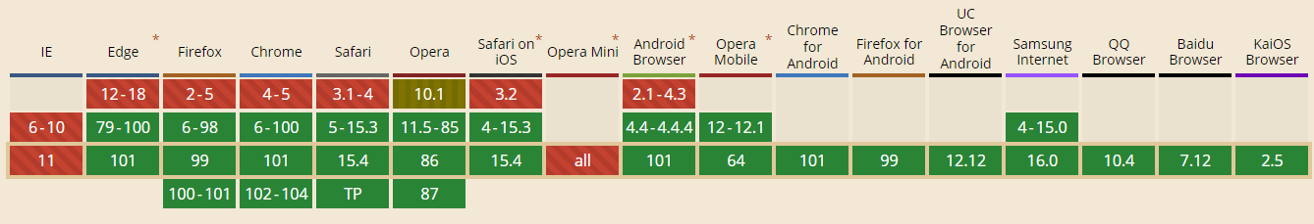
Core (cont.)
SSE browser support until May 2022

Slide 13
Implementations
Javalin: lightweight Java and Kotlin web framework
jEaSSE: Server-side asynchronous implementation for Java servlets and Vert.x
Spring WebFlux: server and client side Java implementation built on reactive streams and non-blocking servers
Jersey: has a full implementation of JAX-RS support for Server Sent Events as defined in JSR-370
Akka HTTP has SSE support from version 10.0.8
Micronaut: HTTP server supports emitting Server Sent Events
JeSSE: Event Source for server-sent event emission
Play: Event Source for server-sent event emission
SSE Client: SSE Client library

Slide 14
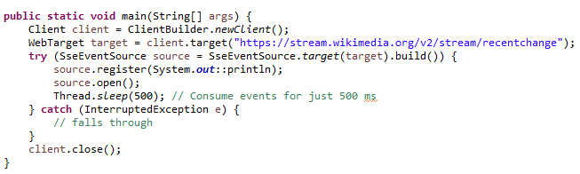
Implementations (cont.)
Jersey Client

Slide 15
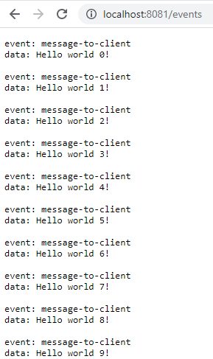
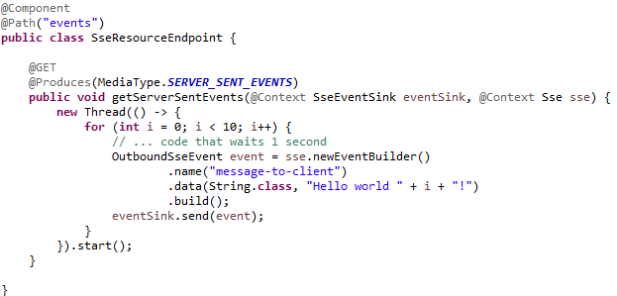
Implementations (cont.)
Jersey Server

Slide 16
SSE vs WebSockets
WebSockets | Server-Sent Events
WebSockets has the ability to transmit both binary data and UTF-8. | SSE is limited to UTF-8 only.
WebSockets are bidirectional (allowing communication between the client and therefore the server). | SSE is mono-directional it does not support bidirectional.
WebSockets are more complex and task-demanding to set up. Because it requires a ton of upfront work. | Compared to WebSockets, SSE is faster and more suitable to set up.
When connections are terminated WebSockets don’t automatically recover – it should be done manually and is part of the reason why there are many client-side libraries in existence. | SSEs, come with automatic reconnection, event IDs, and the ability to send arbitrary events.
Browser support compatibility is more with WebSockets than SSE but browsers that are older than 2011 do not support WebSocket connections. | SSEs are most appreciated in the cases like updating statuses, push notifications, newsletters and news feeds because they support mono-directional communication.

Slide 17
Conclussion
Simpler protocol
Has no issues with firewall doing packet inspection
Built-in support for re-connecting and event-id

Slide 18

Bibliography
https://www.geeksforgeeks.org/difference-between-server-sent-events-and-websockets-in-html5
https://ably.com/topic/server-sent-events

Slide 19
Questions ?

